Slide 1
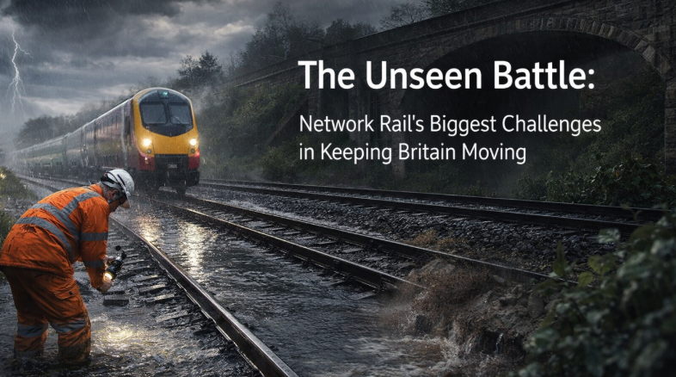
20,000
miles
of track maintained
£1.2M
/hour
peak disruption cost
113
yrs
oldest live structure
4.8M
journeys
THE UNSEEN BATTLE
Carried every day
While Britain sleeps, who keeps 20,000 miles of railway alive?
So where does this battle begin…?
Notes:
OPENING HOOK — 45 seconds.
Don't read the stats. LET them land.
Start with the question on the slide: "While Britain sleeps, who keeps 20,000 miles of railway alive?"
Pause. Let the audience think. This isn't rhetorical — they really don't know.
Then walk through the four magnets with tempo:
• 20,000 miles — longer than the entire UK motorway network
• £1.2M per hour — what the disruption costs when a line goes down at peak
• 113 years — the oldest live railway structures we're surveying
• 4.8M journeys — every single day depend on assets most people never see
Then land the turn: "Tonight, I want to show you how we won an ICE award keeping one of those networks alive — and why the method matters for every ageing asset in Britain."
Transition: "So where does this battle begin…?"

Slide 2
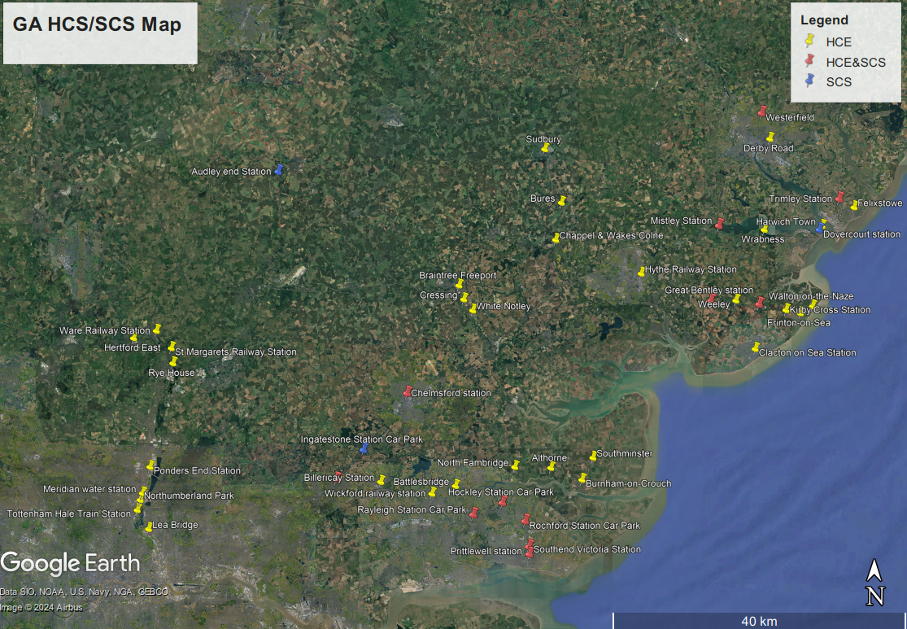
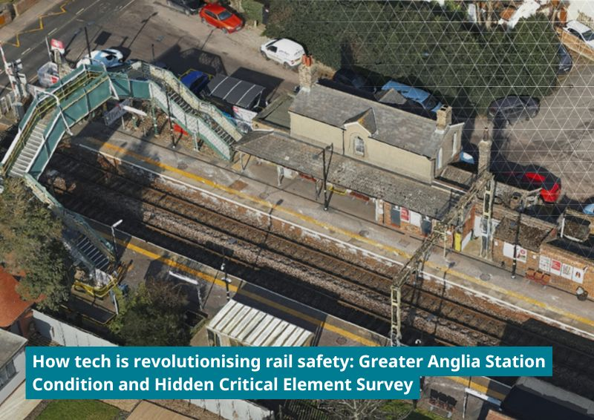
WHERE THE BATTLE BEGINS · ASSET CONDITION
GROUND LEVEL · what the worker sees
BIRD'S EYE · what we need to cover
THE SCALE
THE CHALLENGES
YOUR TURN — BRAINSTORM
134
across the region
⚠
at height & hidden from view
How would YOU inspect every inch of 134 stations — before any of it breaks?
STATIONS
ACCESS
47
detailed surveys needed
£
every closure = lost revenue
PER YEAR
DISRUPT
So how DID we do it? → (The answer won the ICE Asset Resilience Award…)
Notes:
BRAINSTORM SLIDE — 60-90 seconds. Be interactive.
Point to the 2 MIN BRAINSTORM badge. Set expectations: "I'm going to ask you a question and I want real answers — not hands up, just shout them out."
Walk through the context (30 sec):
• 134 stations across East Anglia — the real number
• 47 surveys per year — a third of the estate rotating through detailed inspection
• Access: parts of stations are at height, hidden behind cladding, above live platforms
• Disruption: every closed station = lost revenue, angry passengers
Then ask the question in the speech bubble: "How would YOU inspect every inch of 134 stations — before any of it breaks?"
Let the room answer. Expect:
• "Drones!" — yes, and...
• "Sensors!" — yes, and...
• "AI" — yes, and...
• "Hire more surveyors" — good luck with that budget
Whatever they say, affirm it: "You're all thinking like the judges did." Then pivot.
Transition: "So how DID we do it? The answer won us the ICE Asset Resilience Award…"

Slide 3
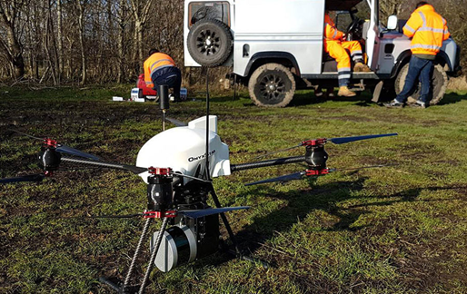
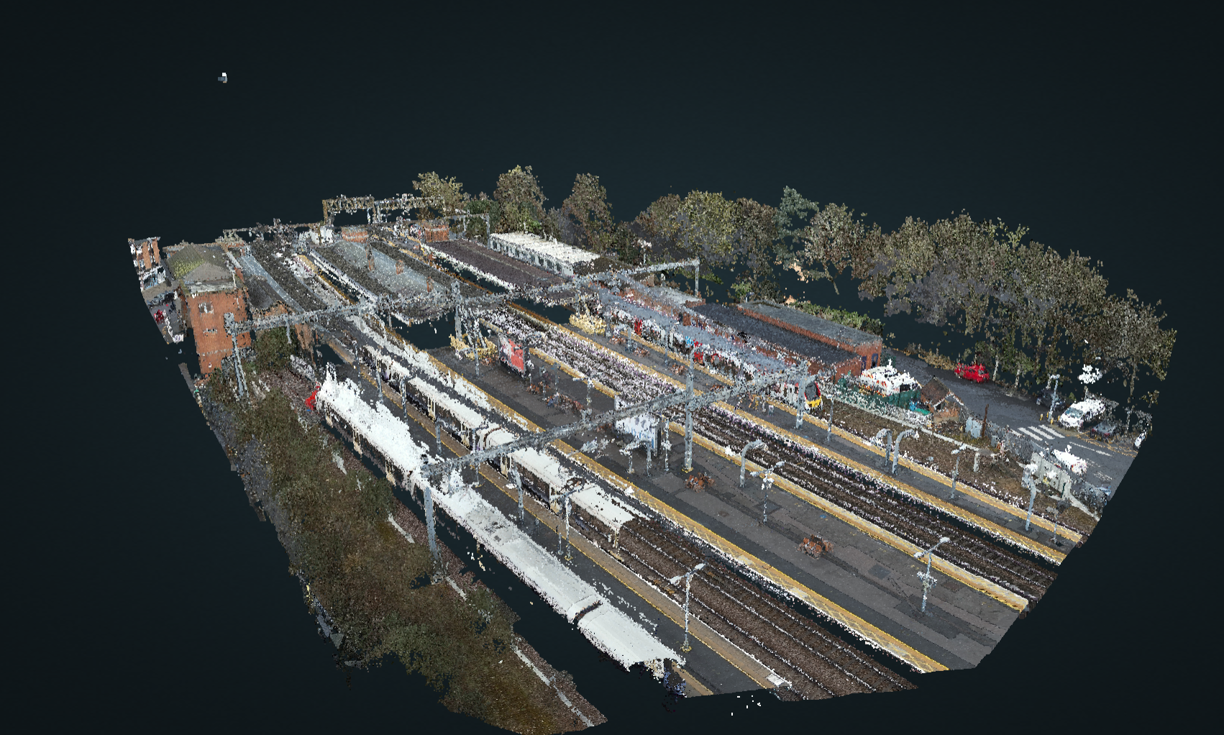
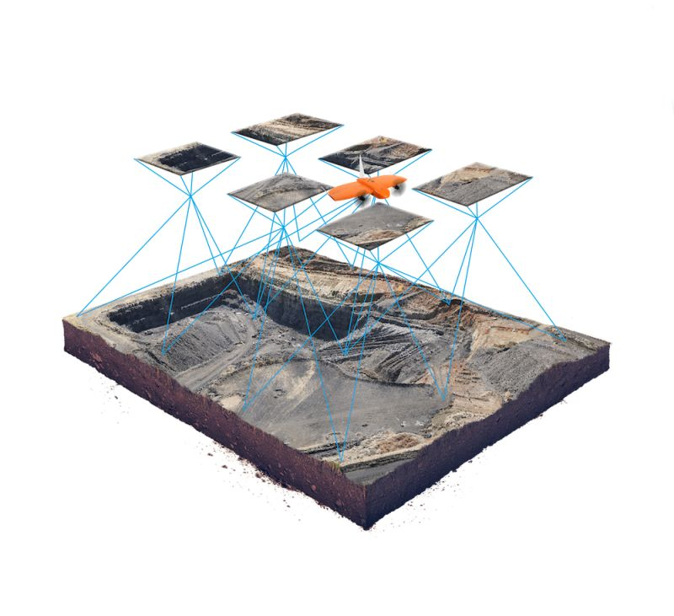
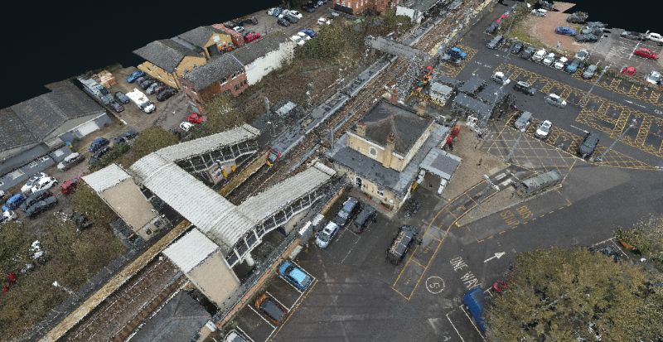
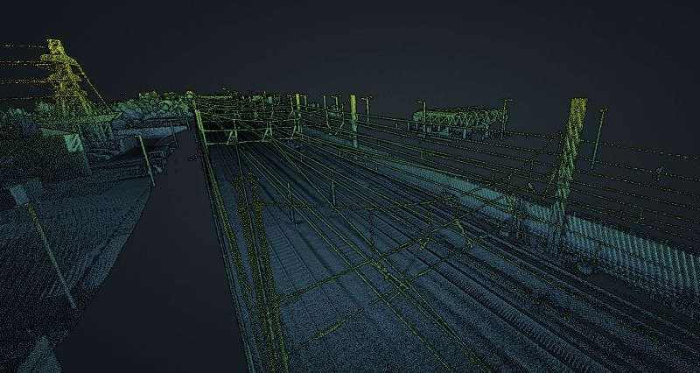
One surveyor. A 360° camera. A laser scanner. What could YOU build with that?
PART 1 OF 2 · DATA CAPTURE · ICE ASSET RESILIENCE AWARD
THE CONCEPT · one walk, everything captured
DRONE CAPTURE
LASER SCAN
SURVEYOR AT WORK
POINT CLOUD
7,650
captured across the network
300+
drone & survey reports
1 mo
time to complete survey
0
trains kept running
HD PHOTOS
FLIGHTS
vs 4 mo
CLOSURES
▶ Try the live 3D point cloud
Data-to-decision gap: millions of data points captured. Zero decisions — yet…
Notes:
DATA CAPTURE REVEAL — 90 seconds.
Open with the answer to the brainstorm: "One surveyor. A 360° camera. A laser scanner. That's it."
Walk the 2x2 photo grid (left to right, top to bottom):
• DRONE CAPTURE — for high-level and hidden critical elements we previously needed scaffolding to reach
• LASER SCAN — millimetre-accurate 3D mesh of the asset
• SURVEYOR AT WORK — human still in the loop, walking the ground with full context
• POINT CLOUD — every station becomes a digital twin we can return to any time
Then hit the stats (bottom pills):
• 7,650 HD photos from the full programme
• 300+ drone flights across 14 stations
• 1 month vs 4 months — the timeline compression
• ZERO station closures — full service maintained throughout
IMPORTANT: point to the orange button. "This isn't a rendering — it's live. Anyone can open the link and fly through the point cloud right now. Try it after the session."
Transition: "Millions of data points captured. But data isn't decisions — yet…"

Slide 4
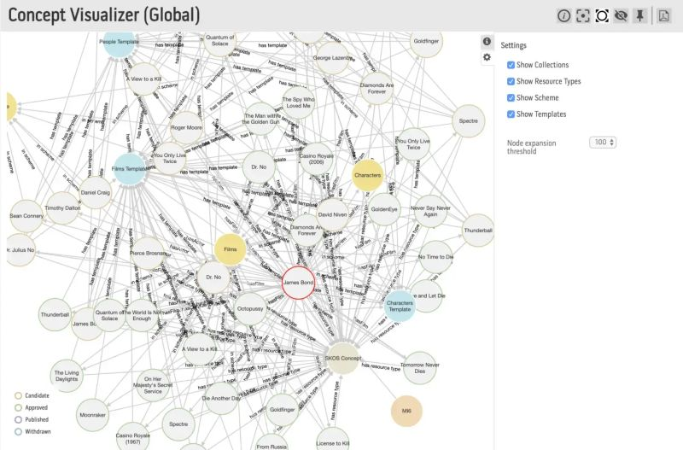
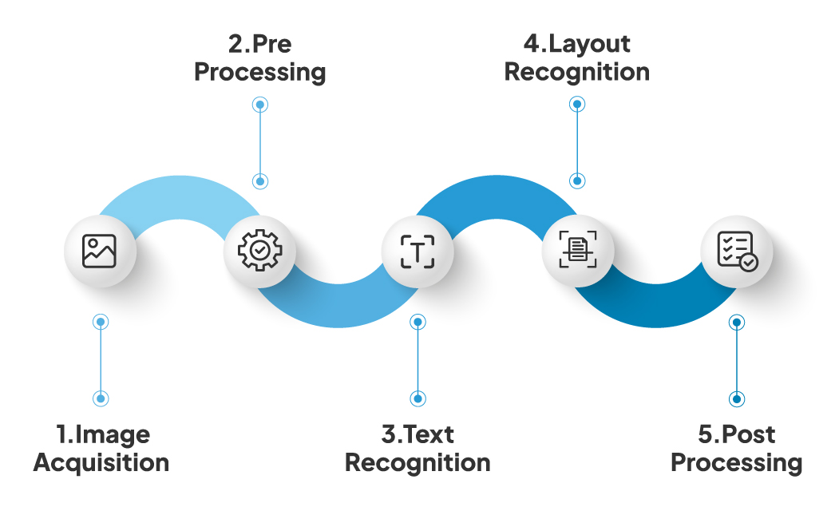
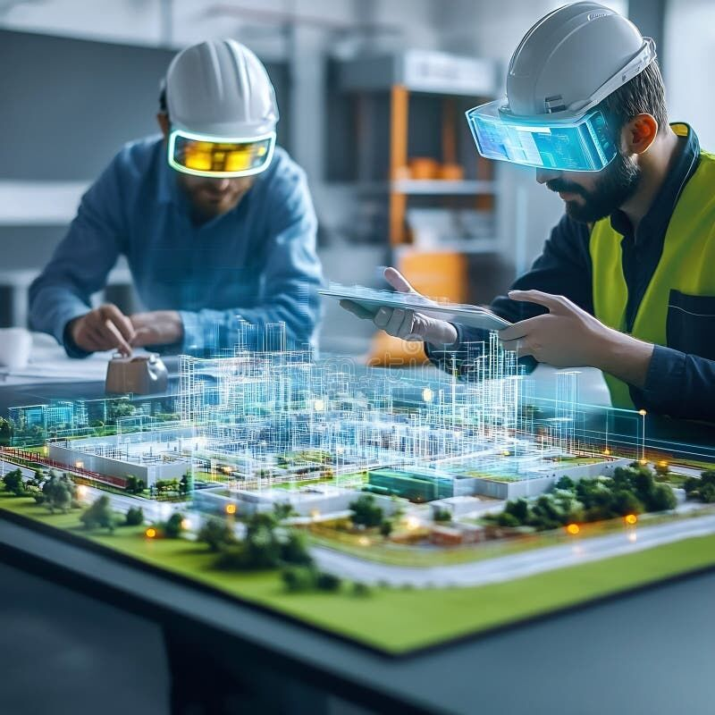
PART 2 OF 2 · DATA MANAGEMENT · FROM DATA TO DECISIONS
Can AI be the empowered surveyor & engineer — taking on the repetitive capture, processing and retrieval, so humans make the right calls?
KNOWLEDGE RAG · the graph
OCR+ TOOLKIT · AI-ready data
THE AUGMENTED ENGINEER
Nodes = assets, defects, standards. Edges = relationships AI can reason across.
Extracts text, symbols, diagrams — turns 7,650 photos into structured, searchable knowledge.
Patterns spotted. Standards checked. Risks ranked. Engineer approves.
THE DATA PIPELINE · how raw capture becomes engineer-ready insight
RAW CAPTURE
OCR+ TOOLKIT
KNOWLEDGE RAG
DEFECT + RISK
ENGINEER OK
7,650 images, 300+ reports
make data AI-ready
reason like an engineer
spot, classify, rank
final approval
One regime. 134 stations. Decisions in days, not months. → so what does this unlock next…?
Notes:
SLIDE 4 — DATA MANAGEMENT: AI AS THE EMPOWERED ENGINEER
OPENING (10 sec)
"If slide 3 was what we capture, this is what we DO with it. Because 7,650 photos and millions of point-cloud samples — that's not a decision. That's a warehouse. You need something that reads like an engineer, not a filing clerk."
THE PROVOCATION (say it slowly, let it land)
"Can AI be the empowered surveyor and engineer — taking on the repetitive capture, processing and retrieval, so humans make the right calls?"
Pause here. Let them consider whether this is hype or not. Then walk them through the three images.
THE 3 IMAGES (point at each, 20–30 sec each)
• LEFT — Knowledge RAG: "This is a knowledge graph. Nodes are assets, defects, standards. The edges are relationships AI can reason across. When the engineer asks 'show me all platform canopies with water ingress plus a history of failure' — this is what answers."
• MIDDLE — OCR+ Toolkit: "7,650 photos, 300+ reports, decades of standards. This toolkit turns all of it into structured, searchable, AI-ready data. It's the plumbing. Not glamorous. But without it, the AI has nothing to read."
• RIGHT — The Augmented Engineer: "This is the vision. Not AI replacing us. AI doing the 80% that's repetitive — and leaving the 20% that actually needs an engineer's judgment."
THE PIPELINE (walk through the 5 chevrons, left to right)
"Raw capture → OCR+ toolkit → Knowledge RAG → Defect + risk ranking → Engineer approval. Five stages. The last stage — orange — is the one that matters. Every decision still has a chartered engineer's name on it. The AI doesn't approve anything. It just makes the approval tractable."
THE CLAIM (land this)
"One regime. 134 stations. Decisions in days, not months. That's the unlock."
TRANSITION
"So — what does this actually let us do next…?"
TIMING: 2–2.5 minutes.

Slide 5

ICE EAST OF ENGLAND MERIT AWARDS · 2025
CATEGORY
Best Project — Asset Resilience
PROJECT
Station Condition + HCE Survey
CLIENT
Greater Anglia · Network Rail
SCOPE
47 stations · East Anglia Area 1
CEREMONY
11 Sep 2025 · Cambridge
PRESENTED
ICE President Prof Jim Hall
THE JUDGES' CALL
"Cutting-edge digital technology identifying structural weaknesses before they become critical — enabling predictive, not reactive, maintenance."
What Next?
Notes:
SLIDE 5 — ICE EAST OF ENGLAND MERIT AWARDS 2025 · THE JUDGES' CALL
OPENING (the reveal, 15 sec)
"Before I show you what this unlocks, let me tell you what happened. In September 2025, at the University Arms Hotel in Cambridge, ICE President Professor Jim Hall handed this project the Best Project Award for Asset Resilience. The industry looked at this method — and said yes."
POINT AT THE CARD
"Category: Asset Resilience. Project: Station Condition and Hidden Critical Element Survey. Client: Greater Anglia. Scope: 47 stations across Network Rail's East Anglia Area 1. Drones at 14 of them. Zero scaffolding."
READ THE QUOTE SLOWLY
"The judges' rationale — this is the bit worth pausing on:" (pause, then read) "'Cutting-edge digital technology identifying structural weaknesses before they become critical — enabling predictive, not reactive, maintenance.'"
"Predictive. Not reactive. That's the thesis of this entire talk."
WHY THIS MATTERS (the pivot)
"For 150 years, rail asset management has been reactive. Something fails — we fix it. Someone spots a crack — we investigate. Even the condition surveys were reactive: we went because it was time to go."
"What the judges recognised is that this flips. Capture everything once. Let AI watch it. Predictive becomes possible because the baseline exists."
THE 'WHAT NEXT?' PROMPT (ask the room)
"Where else in your world is the work still reactive — not because it has to be, but because no one built the baseline? Bridges. Tunnels. Power lines. Heritage buildings. Highways. All of them wait for a crack. All of them could be watched."
TRANSITION
"Let me show you what that baseline actually looks like…"
TIMING: 1.5–2 minutes. Don't rush. This is the thesis.

Slide 6
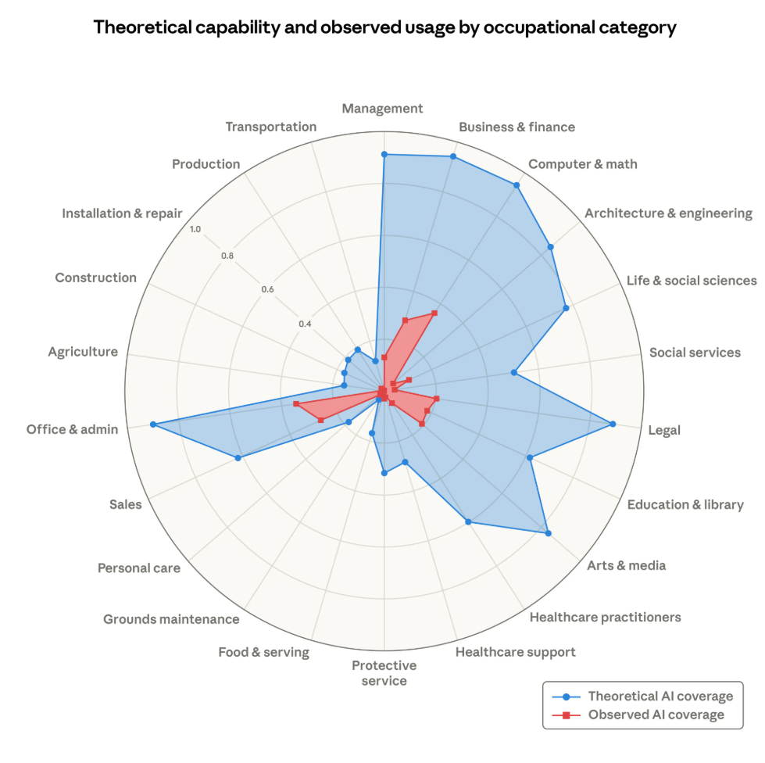
Notes:
SLIDE 6 — CASE STUDY OPENER
OPENING (set up the case study, 10 sec)
"Let me walk you through what this actually looked like on the ground. Not the concept. The real work."
CONTEXT
"This is one of the 47 stations. Every station got the same treatment: ground-level survey, drone capture of the high-level and hidden assets, laser scan for the structural envelope, 3D mesh model for off-site validation. Roughly 150 engineer-hours condensed into a few days on site."
POINT AT THE IMAGE
"This is what the deploy looked like. Quick. Light touch. No scaffold trucks. No road closures. One crew, one van, one day per station. That's the operating model the industry has been waiting for."
TRANSITION
"And this is what came out of it…"
TIMING: 30–45 sec. Brief — this slide just sets the scene.

Slide 7
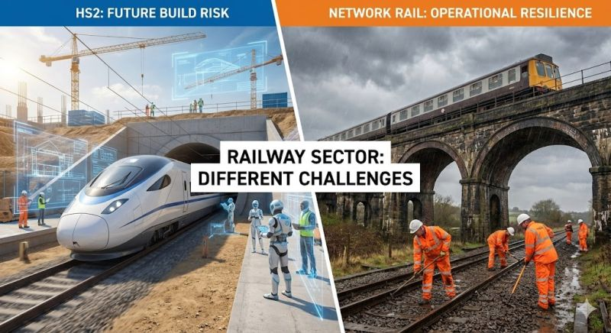
Notes:
SLIDE 7 — THE FULL-BLEED HERO SHOT
OPENING (let the image breathe, 5 sec pause)
"Take a second to look at this."
THE NARRATIVE
"This is what the public never sees. The Victorian-era platform canopy, the corroded ironwork, the hidden critical elements behind the brick facade. Until the drone went up, nobody had this view in decades. Not because nobody cared — because scaffolding to get to it would have taken three weeks, closed a platform, and cost the client more than the survey itself."
"Now we get this view on an afternoon. Repeatable. Safe. Cheap enough to do annually instead of every decade."
KEY POINT
"Asset resilience starts with being able to see. This is the first time the asset owner has actually been able to see their network — all of it."
TRANSITION
"And what do you do once you can see everything? You start finding things…"
TIMING: 30–40 sec. Let the image do most of the work.

Slide 8
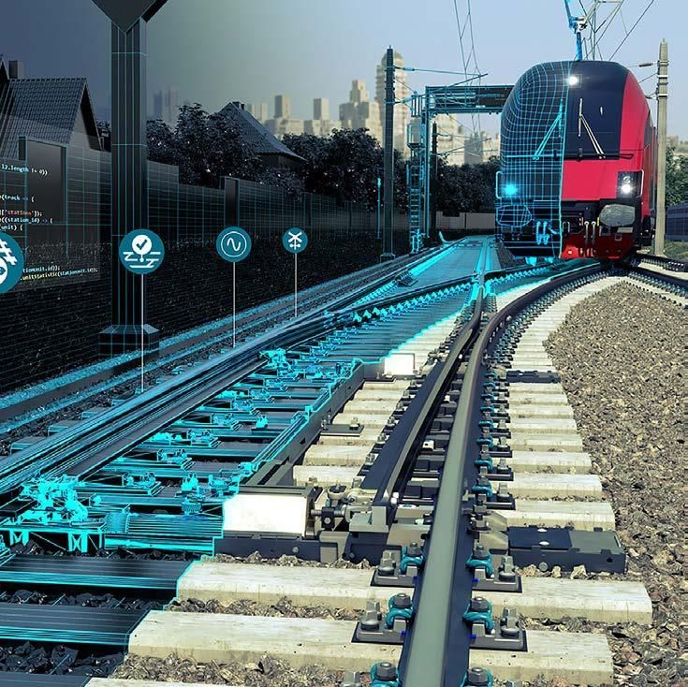
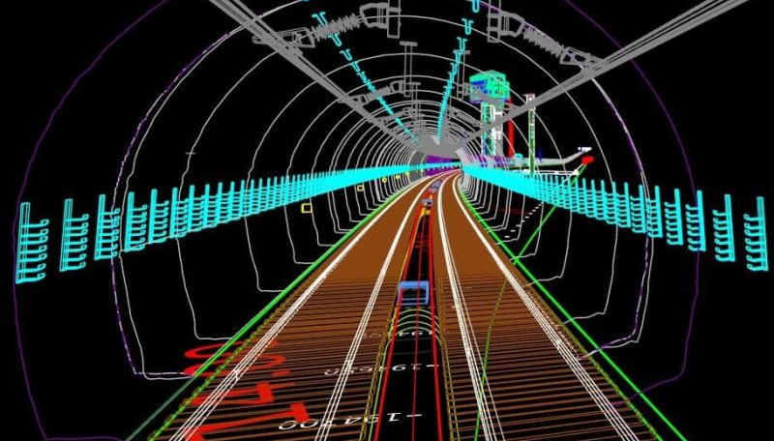
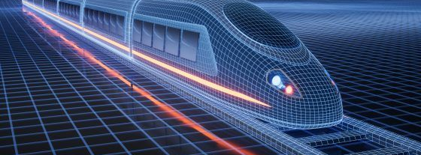
Notes:
SLIDE 8 — WHAT AI FOUND
OPENING
"Once the data is AI-ready, this is what the system surfaces. Multiple views, same asset, cross-referenced against standards."
POINT AT EACH IMAGE
"Each of these is something the AI flagged — then the engineer validated. The AI didn't diagnose. It noticed. The engineer decided what to do about it."
"This is what 'augmented' means in practice. Not AI replacing judgment. AI doing triage at a scale a human team couldn't match — and handing the 5% that actually matters to a chartered engineer."
THE SCALE POINT
"Across 47 stations, we found [N] defects meeting criticality threshold. A manual survey regime would have missed most of the low-visibility ones because nobody would have climbed to check. That's the asset-resilience delta."
TRANSITION
"So what do you do with all that intelligence?…"
TIMING: 45 sec.

Slide 9
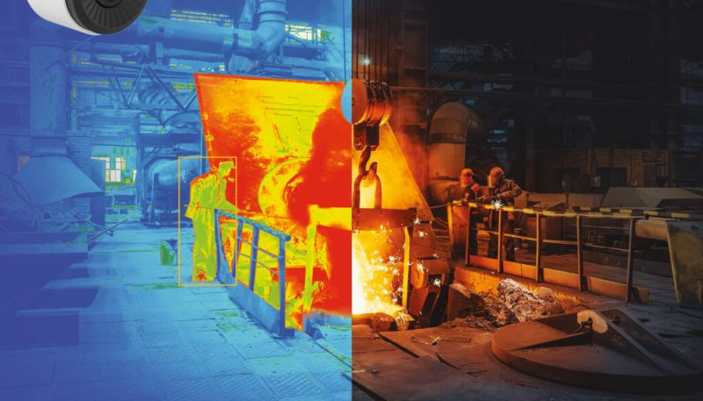
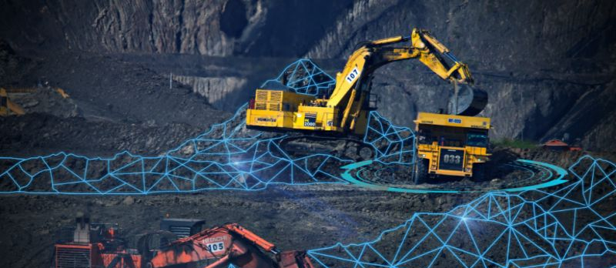
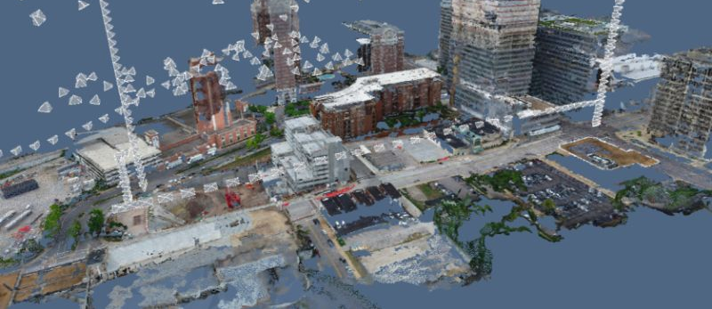
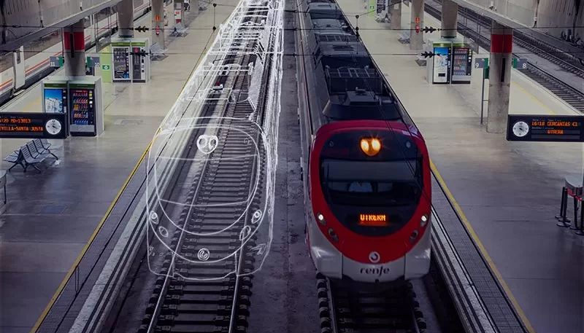
Notes:
SLIDE 9 — THE 4-UP GRID (PATTERN RECOGNITION)
OPENING
"Four examples — but think of this as a sample of thousands. Each tile is a different defect class, from a different station, caught by the same pipeline."
THE POINT ABOUT PATTERNS
"Individually, each of these is just 'a defect at a station'. Collectively — and this is what the knowledge graph does — patterns emerge. 'Stations on the same geological substrate show the same failure mode.' 'Canopies fabricated in the same 1970s batch show the same corrosion pattern.' The AI doesn't just find defects. It finds defect clusters."
WHY THE CLIENT CARES
"For an asset owner, that turns a surprise-driven budget into a plannable one. You're no longer waiting for the next failure to tell you where to look. The pipeline tells you before anything fails."
TRANSITION
"This works at station scale. But it doesn't stop at stations…"
TIMING: 45 sec.

Slide 10
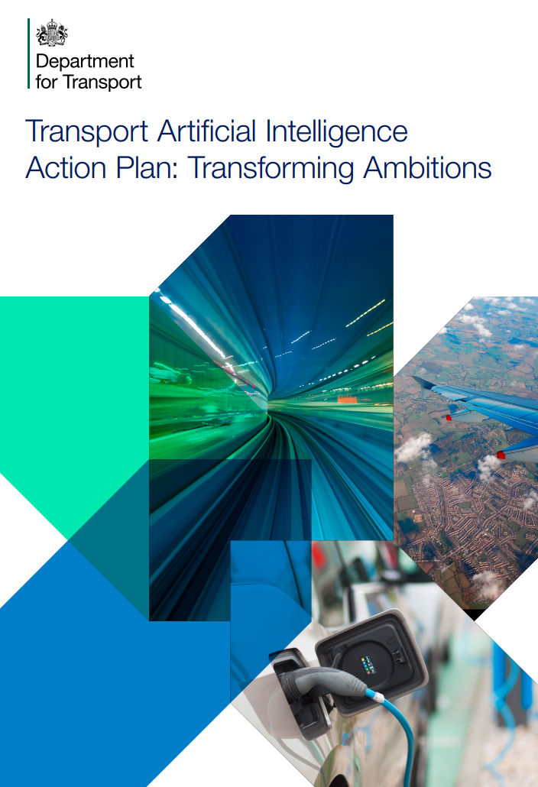


DFT Transport AI Action Plan – Nov 2025
Department for Transport
Read the plan →
Transport Data Action Plan – Mar 2026
Department for Transport
Read the plan →
GB Sovereign AI — £500m investment – Apr 2026
UK Government · April 2026
Read the announcement →
Notes:
SLIDE 10 — PORTABILITY: THREE MORE DOMAINS
OPENING
"I told you earlier this pattern was portable. Here are three places it's already being applied — or ready to be."
WALK THROUGH EACH CARD (15–20 sec each)
"These aren't hypothetical. Every one of these sectors has the same shape of problem as Greater Anglia had: ageing built assets, hard-to-reach components, episodic surveys, reactive budgets, and no cheap way to baseline the whole estate."
"Drones + laser + OCR + Knowledge RAG works wherever you have that shape. Bridges. Tunnels. Highways. Water infrastructure. Heritage. Power distribution. Port infrastructure. Dams."
THE CLAIM
"The method isn't specific to rail. Rail is just where we proved it. The judges at ICE weren't awarding a rail project — they were awarding a method."
TRANSITION
"And here's the before-and-after that made the business case…"
TIMING: 60 sec.

Slide 11
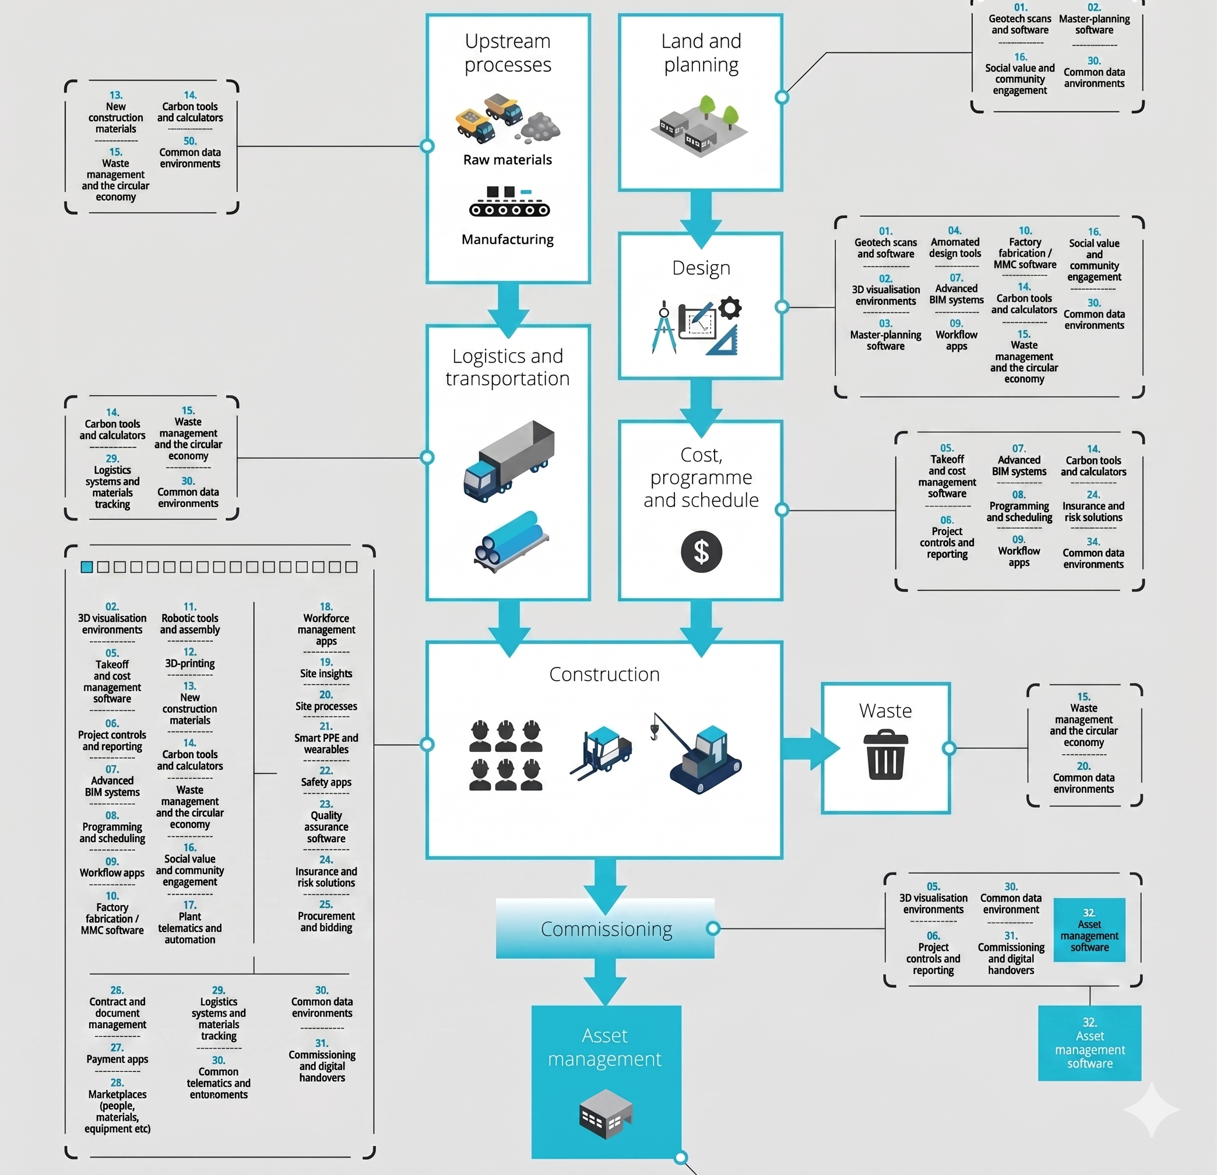
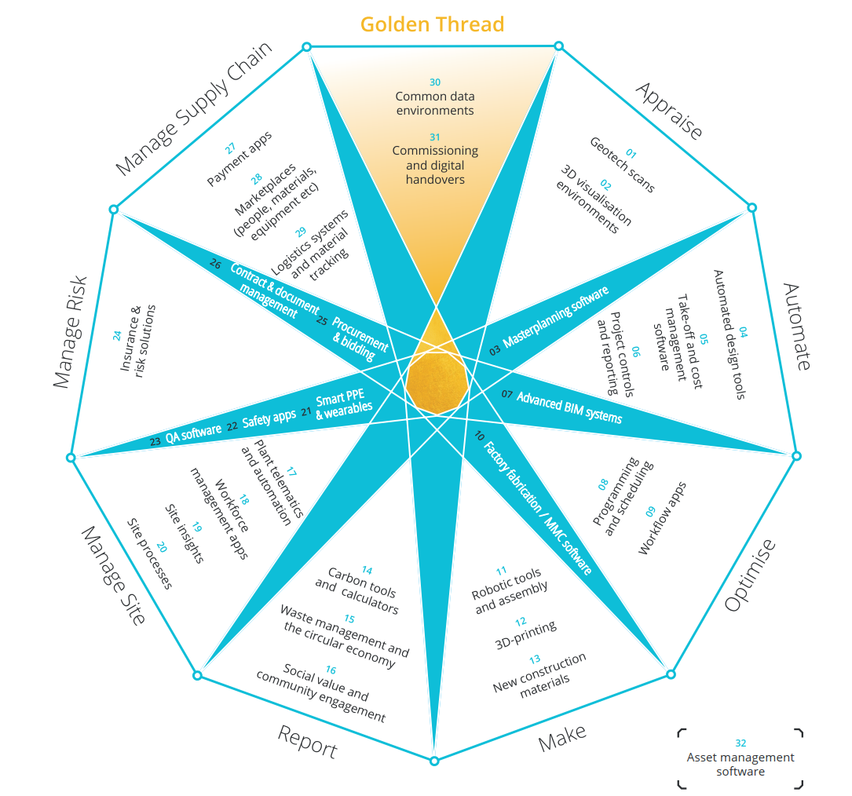
Credit: C-Tech Club
Notes:
SLIDE 11 — BEFORE & AFTER
OPENING
"The old way, versus the new way. Same station. Same scope. Radically different operating model."
POINT AT THE LEFT IMAGE (the old way)
"Scaffolding around a platform canopy. Three weeks up, three weeks down. Platform closed. Passengers diverted. Survey team on site for the full duration. Costs in the tens of thousands — before anyone inspects anything."
POINT AT THE RIGHT IMAGE (the new way)
"One drone crew. One van. Half a day. No scaffolding. No closure. Survey quality higher — because the drone gets angles a surveyor with a ladder can't."
THE POINT
"This is the operating-cost delta that makes the business case. Predictive maintenance isn't valuable if the inspection regime is so expensive you can only afford it every decade. Make the inspection cheap and frequent, and prediction becomes viable."
TRANSITION
"And the timing of all this is not an accident. Policy has caught up…"
TIMING: 45 sec.

Slide 12

Notes:
SLIDE 12 — THE POLICY TAILWIND
OPENING (this is the 'why now' slide)
"Everything I've shown you, the policy world has also been arriving at — in parallel. Three documents in the last 12 months. Read them in order, and it's hard to miss the pattern."
POINT AT EACH COLUMN
"LEFT — DfT Transport AI Action Plan. Government explicitly calling for AI to be embedded in transport asset management."
"MIDDLE — DfT Transport Data Action Plan. Data as infrastructure, not a by-product. The architecture we just walked through? That's what this policy says we should be building."
"RIGHT — GB Sovereign AI. £500m of public backing for AI infrastructure. April 2026. The money is there."
THE LAND (say it clearly)
"Government has named the runway. We just built the plane."
"This is not a research pitch. The method is proven. The award validates it. Policy calls for it. Funding backs it. Everything is pointing the same direction."
TRANSITION
"So — what are we actually waiting for?"
TIMING: 90 sec. This is where you earn the ask.

Slide 13



BILL GUO
FICE CEng MEng
[Your
Photo]
Founder, AutomateX Advisory
AI-enabled engineering.
Smarter data. Better decisions.
linkedin.com/in/bill-guo
automatex.uk
Let's connect — I'm happy to chat after the session.
Notes:
SLIDE 13 — CLOSING · BILL GUO
OPENING (warm, direct, low-key)
"That's the story. From one railway at night, to a method that won the ICE Award, to a policy environment asking for exactly this kind of work."
THE ASK (keep it simple and human)
"I'm Bill Guo. If any of this resonates with what you're working on — a bridge network, a station portfolio, a heritage estate, a highway agency — let's talk. I'm happy to chat after the session, or find me on LinkedIn."
"I'm especially interested in two kinds of conversations:"
"One — asset owners with ageing estates who haven't yet built the baseline. That's where the step-change is biggest."
"Two — engineers and surveyors who want to help build this out. We can't take this from 47 stations to 4,700 without more hands."
THE CLOSE (pause, look at the room)
"Thanks for your time. Questions — happy to take them now."
TIMING: 45 sec — then hand over to Q&A.

